Slide 1
Introduction to Machine Learning

Slide 2
So, how do machines learn?

Slide 3
Let’s see first how do humans learn…

Slide 4
Child learning from explanation
Child: Daddy, what is danger?
Dad: Danger is the possibility of suffering harm or injury.
Child: What is an injury?
Dad: An injury is an instance of being injured.
Child: What is an instance?
Dad: An instance is a specific occurrence of something.
Child: Daddy, does it bother you that I’m asking you these questions?
Dad: Not at all, if you don’t ask you will never know.

Slide 5
Child learning from examples

Slide 6
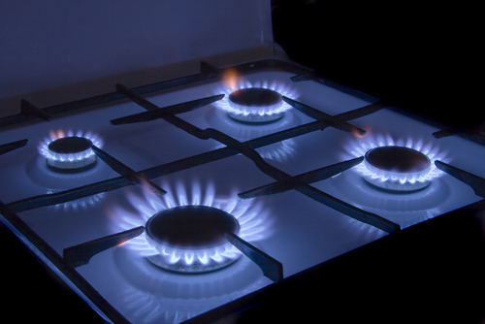
Child learning from examples
Dad: Don’t touch the stove top, it is dangerous!

Slide 7
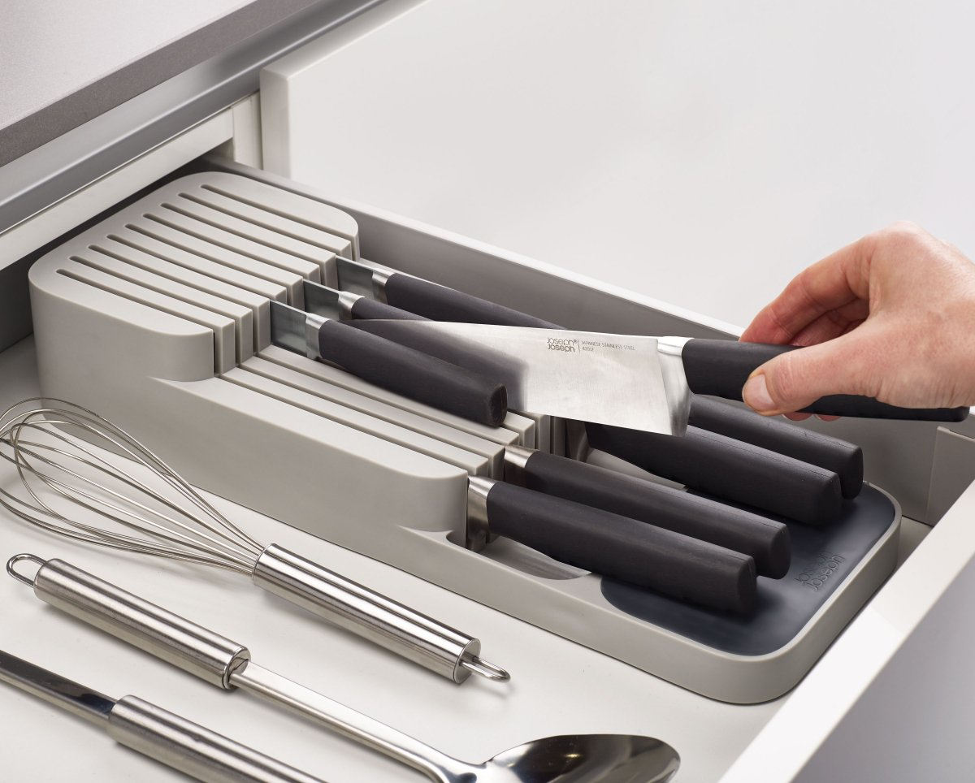
Child learning from examples
Dad: Don’t touch the drawer, the knives there are dangerous!

Slide 8
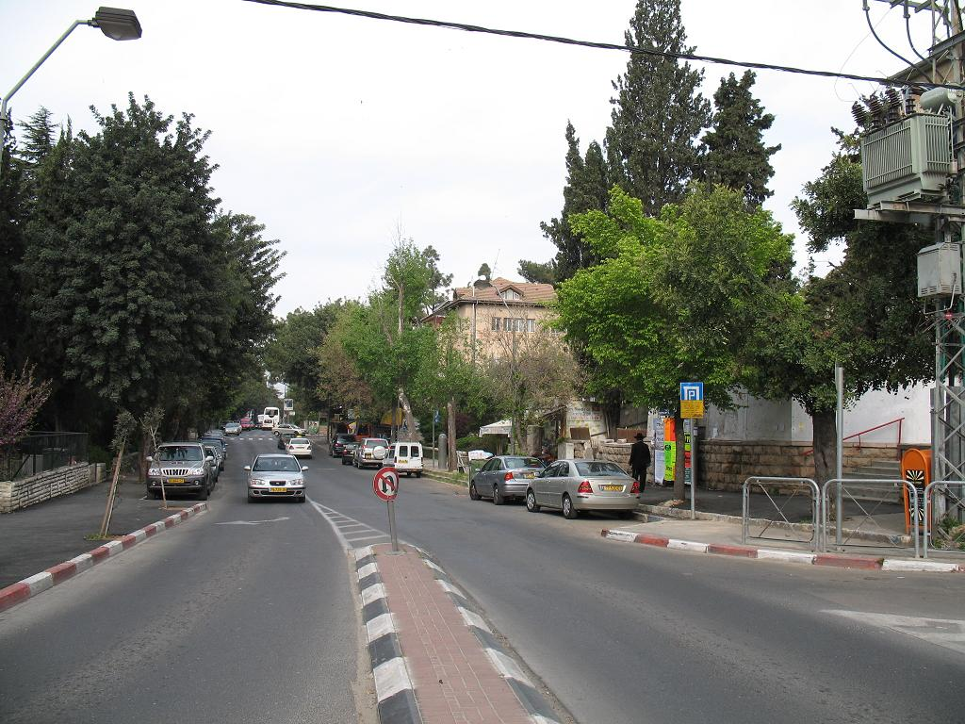
Child learning from examples
Dad: Don’t play there the road is dangerous!

Slide 9
Child learning from examples
Child: Its not fair! Everything is dangerous!

Slide 10
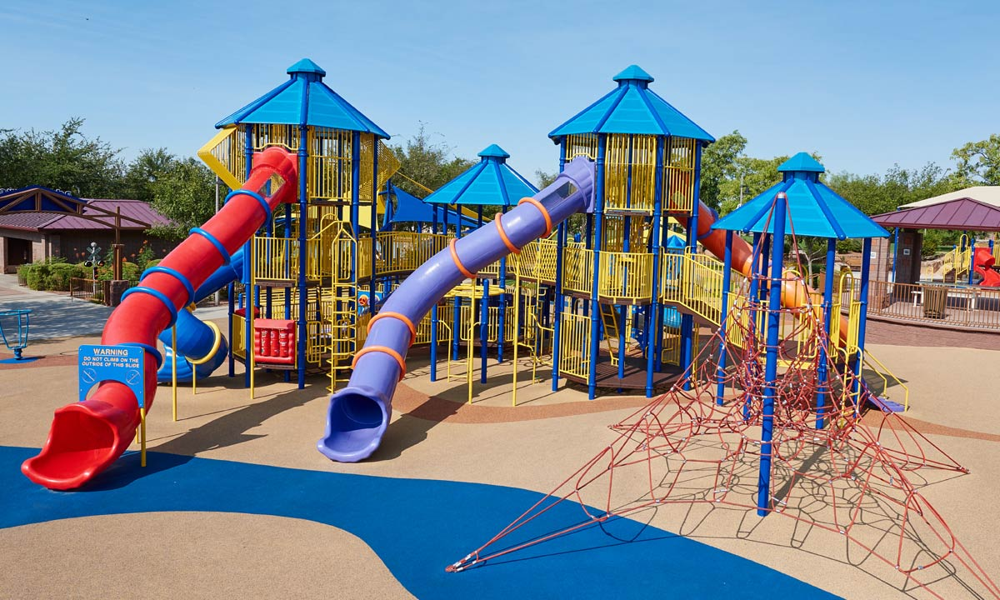


Child learning from examples
Child: Its not fair! Everything is dangerous!
Dad: No. Some things are not dangerous.

Slide 11
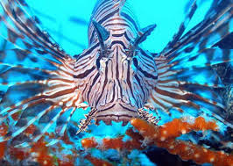
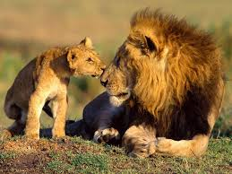
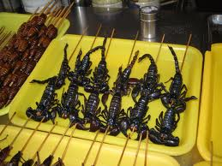
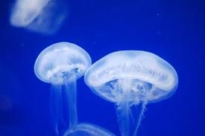
Child learning from examples
Child: And what are those?

Slide 12
Child generalizing
Playgrounds, balls, toys, chocolate,…
Bath, eat, get dressed, sleep
Mother, father, grandma, kindergarten teacher
Power outlet, cars, roads, heights, strangers, knives

Slide 13
Child learning from trial and error
Action | Reaction | Lesson
Touching hot stove | aching hand | Do not touch again
Playing with toys | Fun | Continue playing
Running in to the road | Screaming parent | Don’t run to roads
Running in the house | Fun | Run in the house
Eating chocolate | Fun | Search for chocolate
Eating too much chocolate | Stomach ache | Don’t eat too much
Saying bla bla | No Reaction | Try variations
Saying daddy | Overexcited parents | Do that again

Slide 14
So, how do humans learn?
From explanations
Typically machines don’t learn from explanations (but you can program a machine).
We will not consider that form of learning in the course
From examples
Learn a concept from positive and negative examples. When applied by machines, this is a specific case of Supervised Learning.
Group examples together according to their similarity. When applied by machines, this is a specific case of Unsupervised Learning.
From trial and error
In Machine Learning it is called Reinforcement Learning.

Slide 15
Supervised Learning

Slide 16
Supervised Learning
Objective: Be able to infer an unknown result, given specific values of some explaining features.
Examples: (what is the unknown outcome and what are the explaining features)
Recognize frauds
Predict future revenue

Slide 17
Supervised Learning
Objective: Be able to infer an unknown result, given specific values of some explaining features.
In order to do so, we use an algorithm, to train a model, on a training set, that is consists of actual samples of both the explaining features and the outcome.

Slide 18
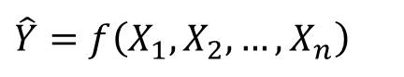
Supervised Learning
X₁ | X₂ | X₃ | … | X_{n-2} | X_{n-1} | X_{n} | Y
x_{1,1} | x_{2,1} | x_{3,1} | … | x_{n-2,1} | x_{n-1,1} | x_{n,1} | y₁
x_{1,2} | x_{2,2} | x_{3,2} | … | x_{n-2,2} | x_{n-1,2} | x_{n,2} | y₂
. . . | . . . | . . . | … … … | . . . | . . . | . . .
x_{1,m-1} | x_{2,m-1} | x_{3,m-1} | … | x_{n-2,m-1} | x_{n-1,m-1} | x_{n,m-1} | y_{m-1}
x_{1,m} | x_{2,m} | x_{3,m} | … | x_{n-2,m} | x_{n-1,m} | x_{n,m} | y_{m}
$$\hat{Y}=f\left(X_{1},X_{2},…,X_{n}\right)$$

Slide 19
Supervised Learning
Inference might be:
Prediction (the unknown result is unknown because it didn’t happen yet)
Estimation (the unknown result exists, but it is unknown to us)
Technically these two cases are treated the same but…

Slide 20
Estimation vs. Prediction
In many prediction tasks, the “right” outcome will be eventually revealed, and we will have a new sample, which will allow us to update our model.
In estimation tasks, we will have to be proactive in order to get more data.

Slide 21
Supervised Learning
The unknown outcome might be:
Numeric (e.g., future revenues). In these cases the task is called Regression.
Categorial (e.g., is fraud). In these cases the task is called Classification.

Slide 22
Supervised Learning
A very simple example of a regression model:
We want to be able to predict the selling price of properties in a specific neighborhood.
We conduct a market research and collect the selling prices of properties in the neighborhood, which were recently sold.

Slide 23
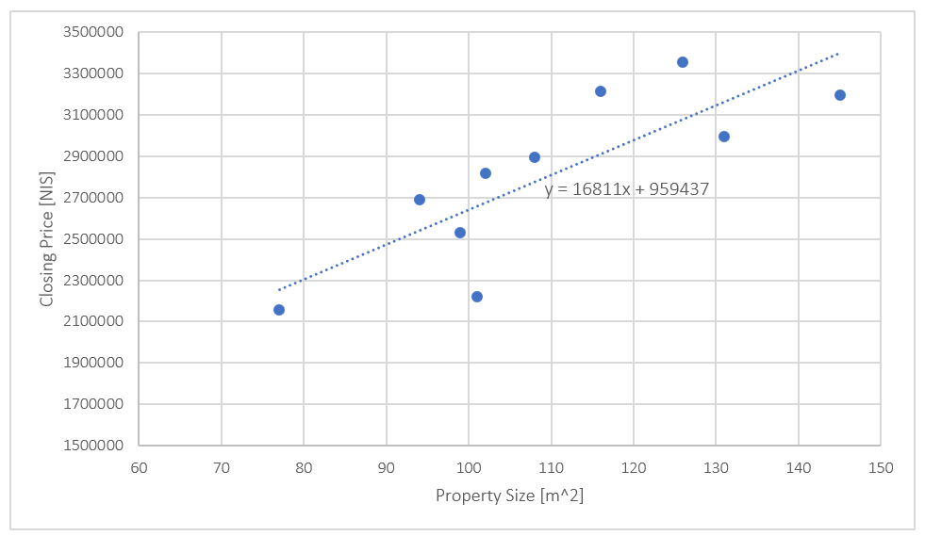
Supervised Learning

Slide 24
Generalization
Generalization = inferring from specific training samples to new observations that we never saw before.
Without generalization there is no learning.
But, in order to do that, we are searching for a model that will fit the training samples. We might be over fitting and we might be under fitting.

Slide 25
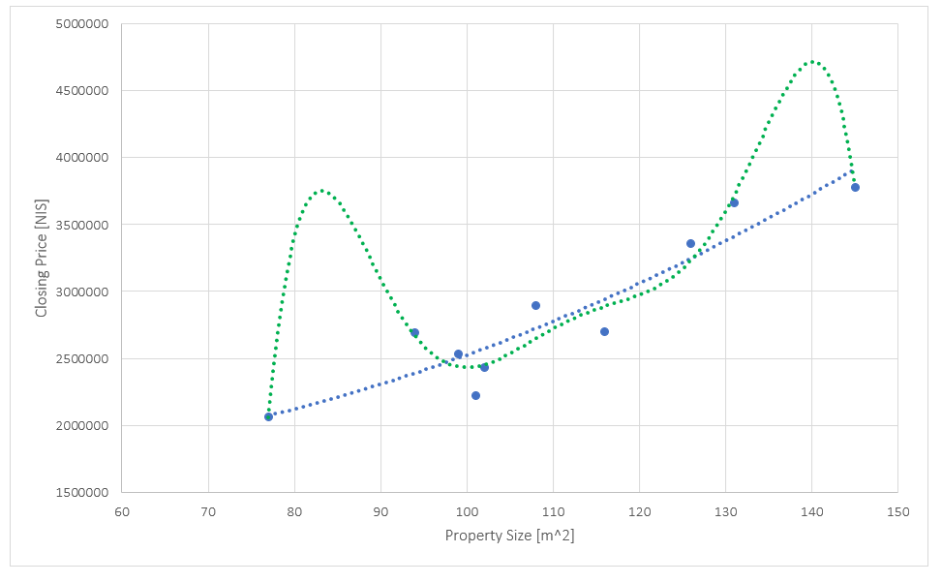
Over fitting

Slide 26
Bias and variance
Fitting = minimizing the error on the training samples.
Two different components may contribute to the error: Bias and Variance

Slide 27
Bias and variance

Slide 28
Bias and variance
High bias = a model that can be improved
High variance = the signal in the data is weak
We want to “learn” the bias, but not the variance!

Slide 29
Occam Razor
The simplest solution tends to be more correct

Slide 30
Over fitting and model complexity
Model complexity = the number of model parameters (explaining features, degree of polynomial, etc.)
A more complex model may better fit the training samples, but it might be over fitted.

Slide 31
Over fitting and model complexity
Important practices:
Always measure the model’s performance on an independent test set.
Always start with simpler models, and add complexity gradually, and only if it is really needed.
If two models seem to perform equally well, choose the simpler one.
Be careful from black boxes.

Slide 32
Over fitting and model complexity

Slide 33
Unsupervised Learning

Slide 34
Unsupervised Learning
Possible objectives:
Extract patterns that characterize some domain
Find an insightful representation of the domain
(Yes, it is a bit abstract)
Unsupervised learning refers to a relatively broad set of tasks, and we will explore some of them later on in the course.

Slide 35
Unsupervised Learning
X₁ | X₂ | X₃ | … | X_{n-2} | X_{n-1} | X_{n}
x_{1,1} | x_{2,1} | x_{3,1} | … | x_{n-2,1} | x_{n-1,1} | x_{n,1}
x_{1,2} | x_{2,2} | x_{3,2} | … | x_{n-2,2} | x_{n-1,2} | x_{n,2}
. . . | . . . | . . . | … … … | . . . | . . . | . . .
x_{1,m-1} | x_{2,m-1} | x_{3,m-1} | … | x_{n-2,m-1} | x_{n-1,m-1} | x_{n,m-1}
x_{1,m} | x_{2,m} | x_{3,m} | … | x_{n-2,m} | x_{n-1,m} | x_{n,m}

Slide 36
Reinforcement Learning

Slide 37
Reinforcement Learning
Objective: train an autonomous agent that will know how to best react to situations. The agent should learn from trial and error (since no one knows in advance what is the best reaction to each and every possible situation)

Slide 38
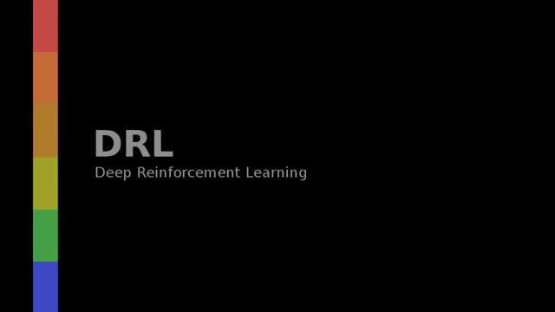
Reinforcement Learning

Slide 39
Reinforcement Learning
Reinforcement learning is one of the developing areas of machine learning, with really impressive achievements (e.g., AlphaGo beating a human world champion). However, the scope of existing solutions is still limited.

Slide 40
From research to production

Slide 41
From research to production
Solving a real-life task requires research, which essence is finding the right processing flow for the data, in order to achieve a business objective.
The research can merely achieve a POC, which thereafter needs to be deployed in production.
Productization of machine learning models is far from being trivial, and we will discuss some of the difficulties during the course.

Slide 42
A machine learning project

Slide 43

Typical project steps

Slide 44
Machine learning project management
Machine learning projects are typically longer than other software projects.
In addition, a project involves three different sets of skills (business, research and engineering).
Consequently, completing a project is complex, and requires management.

Slide 45
Introduction to Machine Learning

